Slide 1
Lecture 3
Note: Some slides and/or pictures are adapted from Lecture slides / Books of
Dr Zafar Alvi.
Text Book - Aritificial Intelligence Illuminated by Ben Coppin, Narosa Publishers.
Ref Books
Artificial Intelligence- Structures & Strategies for Complex Problem Solving by George F. Luger, 4th edition, Pearson Education.
Artificial Intelligence A Modern Approach by Stuart Russell & Peter Norvig.
Artificial Intelligence, Third Edition by Patrick Henry Winston

Slide 2
Outline
Problems and their representation
Goal Driven VS Data Driven
Properties of search Methods
Tree search algorithm
Depth First algorithm
Breadth First algorithm
Iterative Deepening algorithm

Slide 3
Problems and their Representations
Three men and three lions are on one side of a river, with a boat. They all want to get to the other side of the river. The boat can only hold one or two at a time. At no time should there be more lions than men on either side of the river, as this would probably result in the men being eaten.
Representation could be 3, 3, 1 0, 0, 0

Slide 4
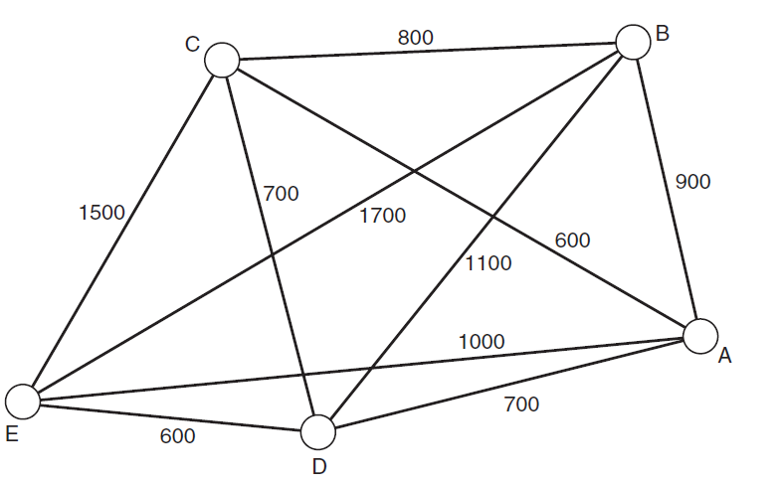
Problems and their Representations
Traveling Salesman problem (NP complete)

Slide 5
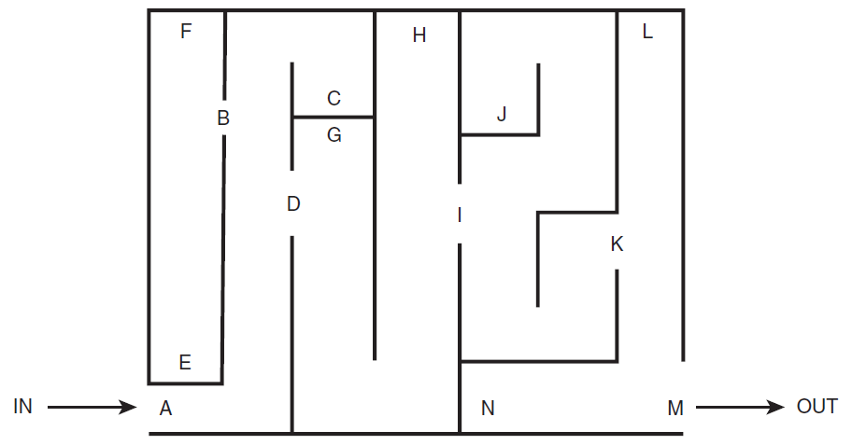
Problems and their Representations
Traversing a Maze

Slide 6
Data Driven or Goal Driven Search
Data-driven search starts from an initial state and uses actions that are allowed to move forward until a goal is reached. This approach is also known as forward chaining.
Search can start at the goal and work back toward a start state, by seeing what moves could have led to the goal state. This is goal-driven search, also known as backward chaining.

Slide 7
Properties of Search Methods
Complexity
Completeness
Optimality
Admissibility
Irrevocability

Slide 8
Complexity
It is useful to describe how efficient that method is, over time and space.
The time complexity of a method is related to the length of time that the method would take to find a goal state.
The space complexity is related to the amount of memory that the method needs to use.

Slide 9
Completeness
A search method is described as being complete if it is guaranteed to find a goal state if one exists.
A method that is not complete has the disadvantage that it cannot necessarily be believed if it reports that no solution exists.

Slide 10
Optimality
A search method is optimal if it finds a solution in the quickest possible time.

Slide 11
Admissibility
An algorithm is then defined as admissible if it is guaranteed to find the best solution.

Slide 12
Irrevocability
Methods that do not use backtracking, and which therefore examine just one path, are described as irrevocable.
Irrevocable search methods will often find suboptimal solutions to problems because they tend to be fooled by local optima—solutions that look good locally but are less favorable when compared with other solutions elsewhere in the search space.

Slide 13
Tree search algorithms
Basic idea:
offline, simulated exploration of state space by generating successors of already-explored

Slide 14
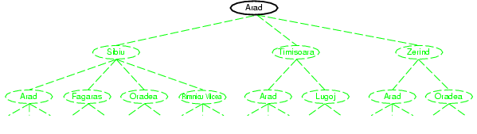
Tree search example

Slide 15
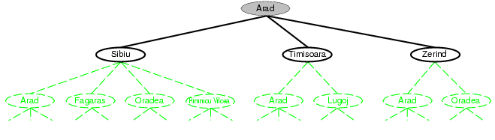
Tree search example

Slide 16
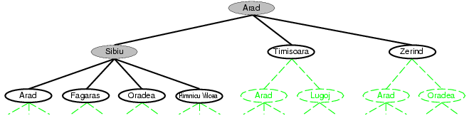
Tree search example

Slide 17
Uninformed search strategies
Uninformed search strategies use only the information available in the problem definition
Depth-first search Breadth-first search Iterative deepening search
etc

Slide 18
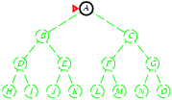
Depth-first search
Expand deepest unexpanded node Implementation:
put successors at front

Slide 19
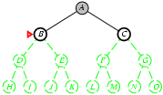
Depth-first search
Expand deepest unexpanded node Implementation:
put successors at front

Slide 20
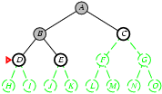
Depth-first search
Expand deepest unexpanded node Implementation:
put successors at front

Slide 21
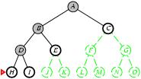
Depth-first search
Expand deepest unexpanded node Implementation:
put successors at front

Slide 22
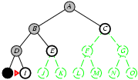
Depth-first search
Expand deepest unexpanded node Implementation:
put successors at front

Slide 23
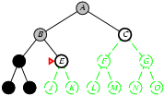
Depth-first search
Expand deepest unexpanded node Implementation:
fringe = LIFO queue, i.e., put successors at front

Slide 24
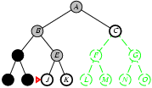
Depth-first search
Expand deepest unexpanded node Implementation:
fringe = LIFO queue, i.e., put successors at front

Slide 25
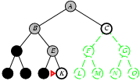
Depth-first search
Expand deepest unexpanded node Implementation:
put successors at front

Slide 26
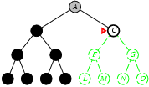
Depth-first search
Expand deepest unexpanded node Implementation:
put successors at front

Slide 27
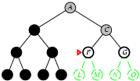
Depth-first search
Expand deepest unexpanded node Implementation:
put successors at front

Slide 28
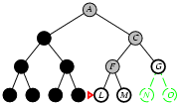
Depth-first search
Expand deepest unexpanded node Implementation:
put successors at front

Slide 29
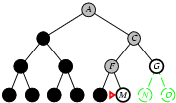
Depth-first search
Expand deepest unexpanded node Implementation:
put successors at front

Slide 30
Depth-first search
Function depth ()
{
queue = []; // initialize an empty queue
state = root_node; // initialize the start state
while (true)
{
if is_goal (state)
then return SUCCESS
else add_to_front_of_queue (successors (state));
if queue == []
then report FAILURE;
state = queue [0]; // state = first item in queue
remove_first_item_from (queue);
}
}

Slide 31
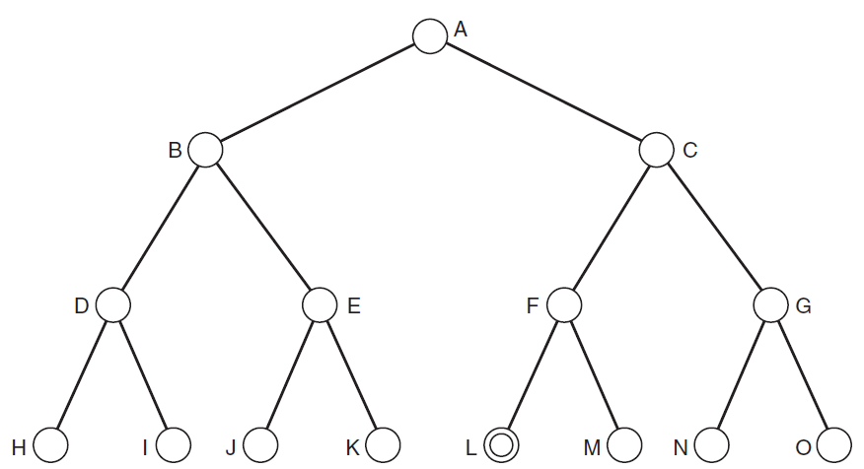
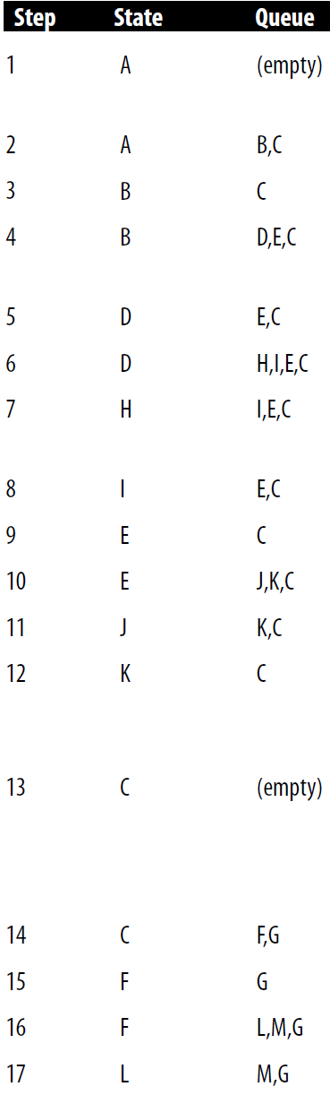
Notes:
Advantages of DFS
It takes lesser memory as compared to BFS.
The time complexity is lesser when compared to BFS.
DFS does not require much more search.
Disadvantages of DFS
DFS does not always guarantee to give a solution.
As DFS goes deep down, it may get trapped in an infinite loop.

Slide 32
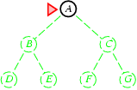
Breadth-first search
Expand shallowest unexpanded node Implementation:
new successors go at end

Slide 33
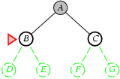
Breadth-first search
Expand shallowest unexpanded node Implementation:
new successors go at end

Slide 34
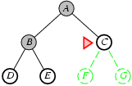
Breadth-first search
Expand shallowest unexpanded node Implementation:
new successors go at end

Slide 35
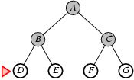
Breadth-first search
Expand shallowest unexpanded node Implementation:
fringe is a FIFO queue, i.e., new successors go at end

Slide 36
Breadth-first search
Function breadth ()
{
queue = []; // initialize an empty queue
state = root_node; // initialize the start state
while (true)
{
if is_goal (state)
then return SUCCESS
else add_to_back_of_queue (successors (state));
if queue == []
then report FAILURE;
state = queue [0]; // state = first item in queue
remove_first_item_from (queue);
}
}

Slide 37
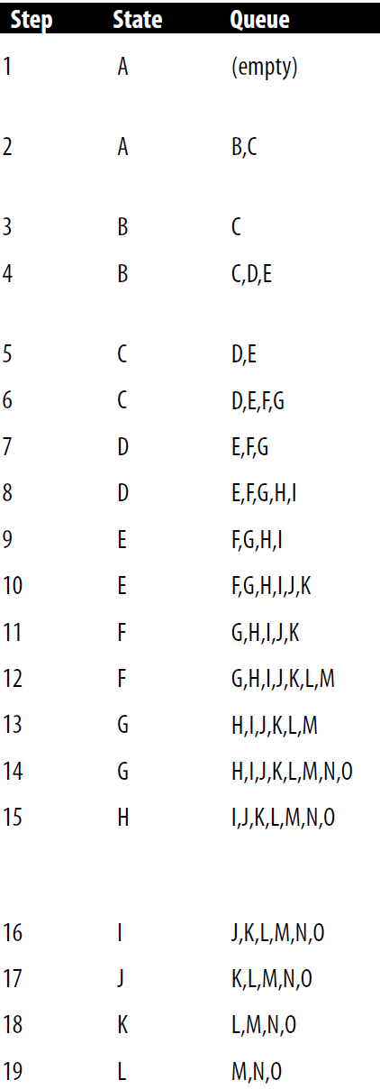
Notes:
Advantages of BFS
BFS will never be trapped in any unwanted nodes.
If the graph has more than one solution, then BFS will return the optimal solution which provides the shortest path.
Disadvantages of BFS
BFS stores all the nodes in the current level and then go to the next level. It requires a lot of memory to store the nodes.
BFS takes more time to reach the goal state which is far away.

Slide 38
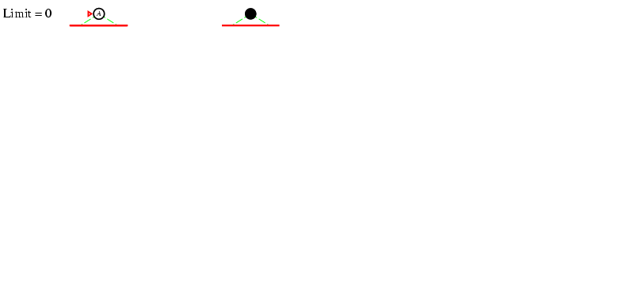
Iterative deepening search l =0

Slide 39
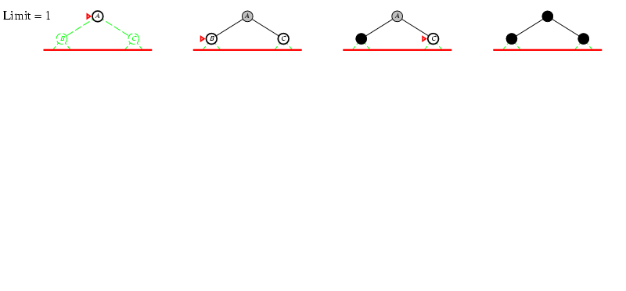
Iterative deepening search l =1

Slide 40
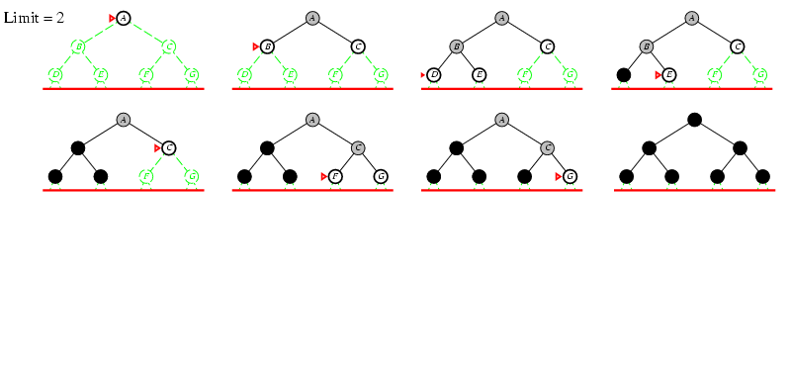
Iterative deepening search l =2

Slide 41
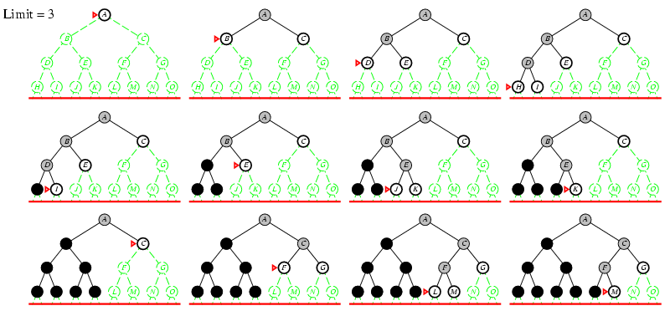
Iterative deepening search l =3

Slide 42

Iterative deepening search
Number of nodes generated in a depth-limited search to depth d with branching factor b:
N_{DLS} = b⁰ + b¹ + b² + … + b^{d-2} + b^{d-1} + b^{d}
GP
Number of nodes generated in an iterative deepening search to depth d with branching factor b:
N_{IDS} = (d+1)b⁰ + d b^¹ + (d-1)b^² + … + 3b^{d-2} +2b^{d-1} + 1b^{d}
For b = 10, d = 5,
N_{DLS} = 1 + 10 + 100 + 1,000 + 10,000 + 100,000 = 111,111
N_{IDS} = 6 + 50 + 400 + 3,000 + 20,000 + 100,000 = 123,456
Overhead = (123,456 - 111,111)/111,111 = 11%

